Slide 1


ABINESH R
Nmid: C5FE8C49EBA7ED0B6AF47BDD12A03E80
Madras Institute of Technology campus, Anna University
Artful Creations: Exploring Generative Adversarial Networks with ARTGAN
1

Slide 2

PROJECT TITLE
Artful Creations: Exploring Generative Adversarial Networks with ARTGAN
3/21/2024 Annual Review
2

Slide 3


AGENDA
Introduction to ARTGAN:
Overview of GANs and Deep Learning with PyTorch.
Introduction to the project's objectives and methodology.
Understanding Generative Adversarial Networks (GANs):
Explanation of GANs as a technique for generative modeling.
Brief overview of deep learning methods used, such as convolutional neural networks.
Exploring Generative Modeling:
Understanding the concept of generative modeling in machine learning.
Explanation of how generative models learn patterns in input data to generate new examples.
The Power of GANs in Image Generation:
Discussion on how GANs can generate new images with statistics similar to the training set.
Examples showcasing the capabilities of GANs in creating realistic and novel images.
Human Perception vs. GANs:
Exploration of human imagination and its limitations.
How GANs can surpass human imagination by generating images beyond human perception.
3/21/2024 Annual Review
3

Slide 4
AGENDA
Example Scenario: Image Manipulation with ARTGAN:
Demonstration of manipulating art images using ARTGAN.
Illustration of how ARTGAN can generate lifelike images from a single source image.
Training and Implementation:
Explanation of dataset acquisition and preprocessing using PyTorch.
Details on the training process and model architecture.
Results and Analysis:
Presentation of generated images and evaluation metrics.
Discussion on the quality and realism of the generated images.
Future Directions and Challenges:
Exploration of future research directions in GANs and generative modeling.
Discussion on challenges and opportunities in the field of image generation.
Conclusion:
Summary of key findings and insights from the project.
3/21/2024 Annual Review
3

Slide 5
PROBLEM STATEMENT
Developing ARTGAN, a Generative Adversarial Network (GAN), to generate realistic art images from paintings. Utilizing deep learning techniques in PyTorch, the project aims to bridge the gap between sketches and lifelike artworks.
3/21/2024 Annual Review
4

Slide 6
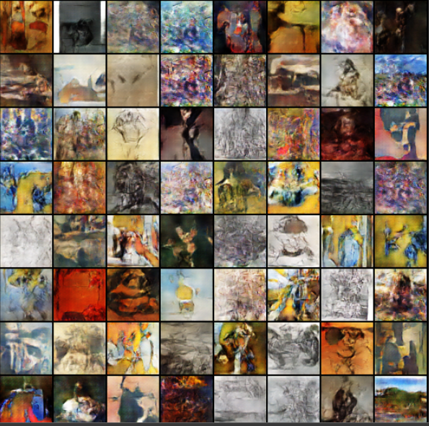
PROJECT OVERVIEW
This project involves generating new art images from the trained model. The Generative Adversarial Network (GAN) architecture, specifically ARTGAN in this case, is trained on a dataset of drawings. Once trained, ARTGAN is capable of generating new, realistic art images that resemble the style and characteristics of the training data. Therefore, the focus is on generating novel art images rather than converting existing ones.
3/21/2024 Annual Review
5

Slide 7

WHO ARE THE END USERS?
Artists and designers: They can use the generated art images as inspiration for their own work or incorporate them into their artistic projects.
Art enthusiasts: Individuals interested in digital art and creativity can explore the diverse range of artworks generated by ARTGAN for enjoyment and inspiration.
Researchers and developers: Professionals in the fields of artificial intelligence and machine learning can study the techniques and advancements in generative modeling demonstrated by ARTGAN for further research and development.
3/21/2024 Annual Review
6

Slide 8
YOUR SOLUTION AND ITS VALUE PROPOSITION
Solution Overview:
ARTGAN is an innovative project that leverages generative adversarial networks (GANs) to create lifelike artistic images. By harnessing the power of deep learning techniques, specifically using PyTorch and Matplotlib, ARTGAN enables the manipulation and generation of art images with astonishing realism.
Revolutionary Artistic Expression: ARTGAN enables the creation of highly realistic and novel art images, revolutionizing artistic expression.
Efficiency and Speed: Streamlined training processes and GPU acceleration ensure efficient and rapid creation of artistic images, saving time and resources.
Unleashed Creativity: ARTGAN empowers artists to explore new realms of creativity, pushing the limits of digital art.
Comprehensive Support: With comprehensive documentation and support, ARTGAN facilitates easy adoption and implementation for users.
3/21/2024 Annual Review
7

Slide 9
THE WOW IN YOUR SOLUTION
Realistic Art Generation: ARTGAN can generate art images that closely resemble those in the training dataset, capturing intricate details, textures, and styles.
Creative Exploration: By allowing artists to manipulate and generate art images in ways previously impossible, ARTGAN opens up new avenues for creative exploration.
Efficiency and Speed: The streamlined training processes and GPU acceleration ensure that ARTGAN can produce high-quality art images quickly and efficiently.
Endless Possibilities: ARTGAN's versatility extends beyond art generation, offering potential applications in image manipulation, style transfer, and more.
3/21/2024 Annual Review
8

Slide 10
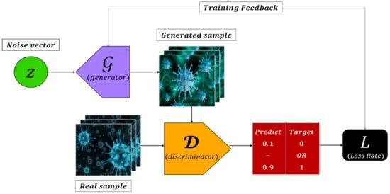
MODELLING
In the context of the ARTGAN project, modeling refers to the creation and training of two key neural network architectures: the generator and the discriminator.
3/21/2024 Annual Review
9

Slide 11
MODELLING
Generator Model:
The generator model takes random noise, typically in the form of a latent vector, as input and learns to generate realistic art images.
It consists of several layers of convolutional and transposed convolutional operations, designed to upscale the input noise into a high-resolution image.
Discriminator Model:
The discriminator model acts as a binary classifier, distinguishing between real and fake images.
It takes an input image and outputs a probability score indicating the likelihood that the image is real.
3/21/2024 Annual Review
9

Slide 12
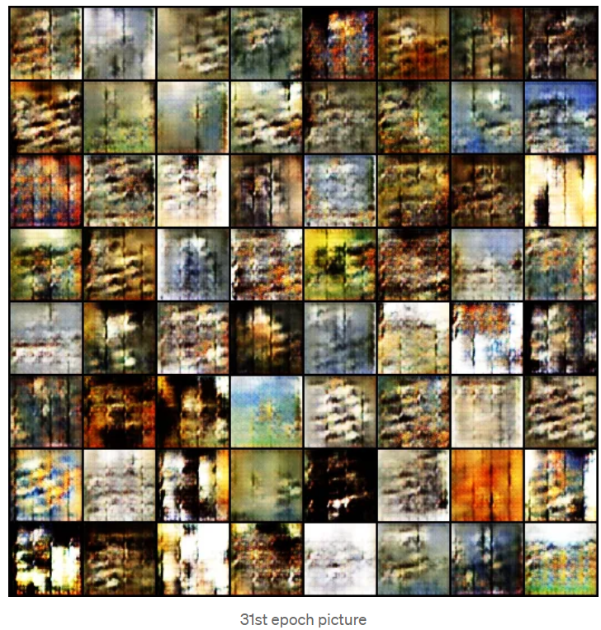
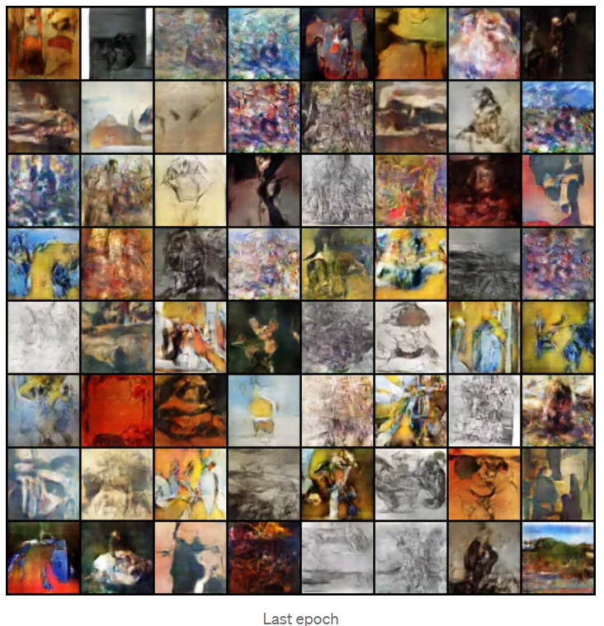
RESULTS
3/21/2024 Annual Review
11

Slide 13
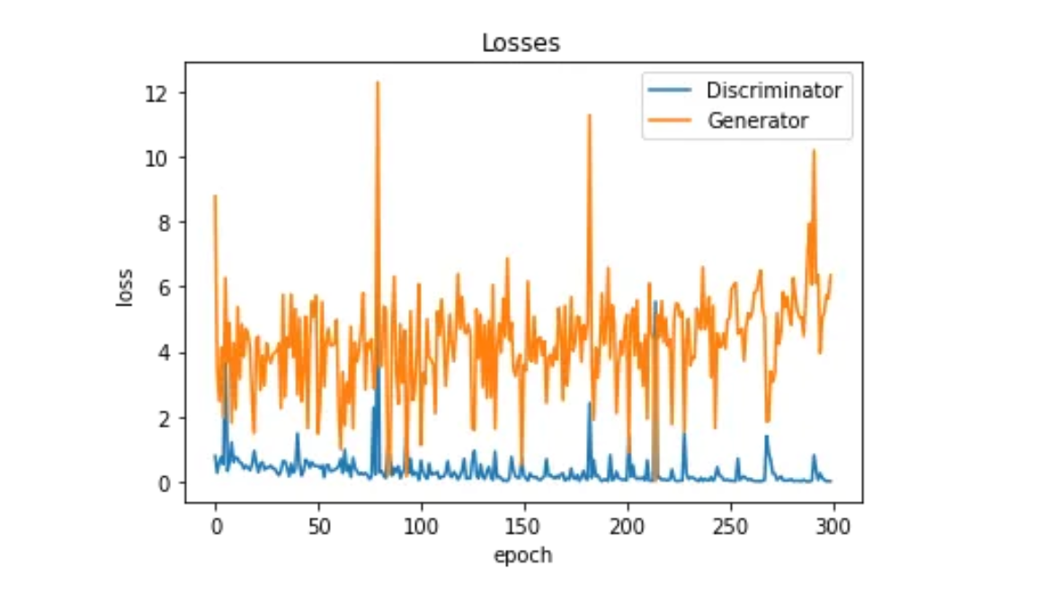
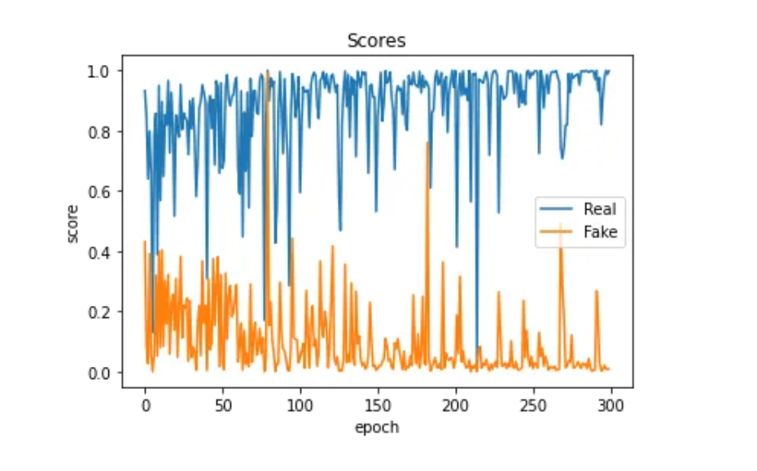
RESULTS
video link
https://drive.google.com/file/d/1gYMrTSHlfTjfszlUJ0gAa1RIaLUEKQ4i/view?usp=sharing
The quality of the fake picture is good, but fake image prediction values are not very good. So now again we can run it using a lower learning rate(lr) and near about 80–100 epochs may be able to increase the fake images prediction value
3/21/2024 Annual Review
11

